Slide 1
Smarter and Intelligent Ways to Train Deep Learning Models

Slide 2
Problem at Hand
Need to experimentally find the best learning rate values and schedule for the global learning rates.
Adaptive Learning rates like AdaGrad , RMSProp , AdaDelta are not computationally simple.
Difficulty in minimizing the loss arises from saddle points rather than poor local minima as saddle points have small gradients that slow the learning process.

Slide 3
Cyclical Learning Rate
Introduction
They are fundamentally different from adaptive learning rate and they can combine with adaptive learning rate
CLR is similar to SGDR methods
Framework to vary learning rate during training and hence helps in letting the global learning rate vary cyclically within a band of values instead of setting it to a fixed value.
Advantage
No need to tune the learning rate.
Obtain near optimal Accuracy for any task
Implementing cyclical learning rate make sure rapid traversal of saddle points plateaus due to increasing learning rates

Slide 4
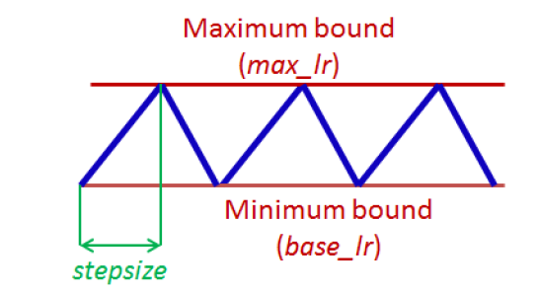
Cyclical Learning Rate
Hyperparameters
Minimum learning rate
Maximum learning rate
Step Size – 2 to 10 times the number of iterations in an epoch
Number of iterations until learning rate reaches the maximum learning rate
Cycle Length – 2 times the Step Size
Number of iterations until learning rate returns to the initial value(minimum learning rate)

Slide 5
1 Cycle Policy
We progressively increase our learning rate from lr_max/div_factor to lr_max and at the same time we progressively decrease our momentum from mom_max to mom_min.
2. We do the exact opposite: we progressively decrease our learning
rate from lr_max to lr_max/div_factor and at the same time we
progressively increase our momentum from mom_min to
mom_max.
3. We further decrease our learning rate from lr_max/div_factor to
lr_max/(div_factor x 100) and we keep momentum steady at
mom_max.

Slide 6
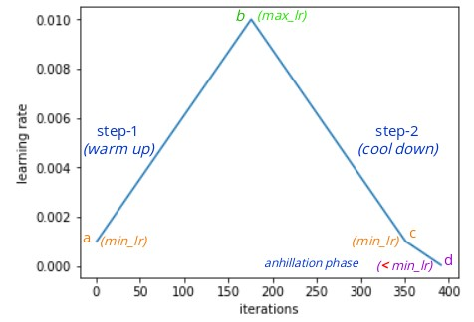
1 Cycle Policy

Slide 7
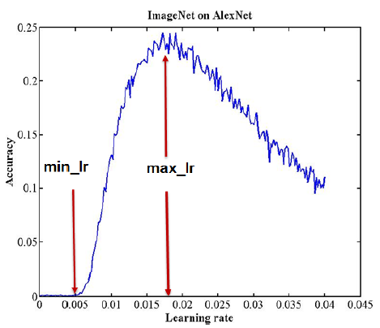
Learning Rate Range Test
Used to determine if super-convergence is possible for an architecture.
How we do it ..
Choose a minimum and maximum learning rate (lr)
Set step size = max_iterations (total epochs)
Plot accuracy vs learning rate(lr finder plot) and choose min lr when accuracy starts to increase and max lr when accuracy starts to decrease

Slide 8
Different Functional Form for varying Learning Rates
Triangular Window(linear)
Welch Window(Parabolic)
Hann Window(Sinusoidal)

Slide 9
References
Super-Convergence: Very Fast Training of Neural Networks Using Large Learning Rates
https://arxiv.org/abs/1708.07120
One cycle policy
https://docs.fast.ai/callbacks.one_cycle.html

